Slide 1

IT Governance Audit
Information Systems Auditing
Class II

Slide 2
Audit & Standards
COBIT 2019
Auditing IT Governance using COBIT 2019

Slide 3
Class Recap

Slide 4
Class Roadmap
IT Governance: Concept
IT Governance: Audit Program
IS Acquisition, Development & Implementation I
IS Acquisition, Development & Implementation II
IS Operation & Business Resilience
Protection of Information Assets I
Protection of Information Assets II
Mid-Term Exam
Basic of Data Analysis
Risk and Control
Parallel Simulation
Analytics and Sampling
Substantive Testing
Intro to SQL
Auditing with SQL
Final Exam

Slide 5
Covered Last Week
What is Governance?
What is IT Governance?
Why IT Governance matters
Governance vs Management

Slide 6
Audit & Standards
#criteria #objectivity #repeatability

Slide 7
Remember What Arens said
“Auditing is the accumulation and evaluation of evidence about information to determine and report on the degree of correspondence between the information and established criteria.”
This definition gives us three pillars:
Evidence
Information being evaluated
Criteria (the benchmark used to judge the information)
Most students and even professionals often forget that the criteria is the centerpiece.
Without criteria, there is no audit, only opinion.

Slide 8
Why Established Criteria Matters in Auditing
It makes judgments objective
It defines “what good looks like”
It reduces arguments with management
It ensures audits are repeatable and comparable
It protects the auditor

Slide 9
Reflection Question
In financial audit, what are the traditional criteria?
In IT/IS Auditing, what is the equivalent of that traditional criteria?

Slide 10
The Landscape of Establishing Criteria in IT/IS Auditing
Because IT is broad, fast-changing, and context-dependent, IT auditors deal with multiple domains under “IT” such as:
IT Governance
Information Security
IT Operations
System Development
Data Management
Infrastructure
Cloud Service
Privacy
Cybersecurity
And so many more!

Slide 11
Diverse Standards Used as Criteria
There is no single “GAAP for IT.” IT auditors typically rely on combinations of:
1. | ISACA Standards & COBIT Framework | The backbone of professional IS auditing and IT governance evaluation.
2. | ISO Standards | The universal best-practice yardsticks for IT processes, security, and risk.
3. | NIST Standards & Framework | The technical and cyber-focused criteria for controls and risk management.
4. | ITIL | The service quality and IT operations benchmark.
5. | Regulations | The non-negotiable legal compliance yardstick.
6. | Internal Standards, Policies, SOPs | The organization’s own promises and auditors verify whether those promises are kept.

Slide 12
In IT Auditing, Criteria Selection is Strategic
The Auditor must understand context hence the audit objective determines the standard.
However, ensuring the standards use is challenging because (for example:
Not every organization uses the same framework
Many controls are custom or informal
Technology evolves faster than standards
Organizations use 3rd party services/providers
Thus, IT audit requires professional judgment to establish fit-for-purpose criteria.

Slide 13
Case 1: Audit of IT Service Management
Audit Objective:
Evaluate the effectiveness of the company’s incident management, change management, and service delivery.
Appropriate Standards:
ITIL (best practice for incidents, changes, service desk)
ISO 20000 (formal ITSM standard)
Internal SOPs (who approves changes, escalation paths)
Why these standards?
IT operations rely on process maturity more than policy frameworks. ITIL provides detailed process guidance, while ISO 20000 sets formal service management requirements.

Slide 14
Case 2: Audit of Information Security Controls
Audit Objective:
Evaluate whether the company has adequate information security governance and controls to protect critical data.
Appropriate Standards:
ISO 27001 → Core security controls
NIST 800-53 → Technical/operational controls (detailed)
Internal security policy → Whether the company follows its own rules
Why these standards?
Security controls are best evaluated using recognized security frameworks, not ITIL or COBIT alone. ISO 27001 provides a high-level ISMS structure, while NIST 800-53 provides deep technical control benchmarks.

Slide 15
Case 3: Audit of Data Privacy Compliance
Audit Objective:
Assess whether PI/PD is collected, processed, stored, and deleted in compliance with laws.
Appropriate Standards:
GDPR / PDPA / UU PDP (depending on jurisdiction)
Internal data protection policy
ISO 27701 (privacy extension to ISMS)
Why these standards?
Privacy audits are compliance-driven hence the law is the primary criterion, not ITIL or COBIT.

Slide 16
Case 4: Audit of IT Governance
Audit Objective:
Assess whether IT activities align with business goals and risks are properly managed.
Appropriate Standards:
COBIT 2019 → Core governance & management objectives
ISO 38500 → Board-level IT governance principles
Internal governance policies → Decision-making roles
Why these standards?
This is a governance audit, so operational frameworks (e.g., ITIL) are not central. COBIT provides end-to-end criteria for alignment, value delivery, risk management, and performance measurement.

Slide 17
COBIT 2019
#Governance #Alignment #ValueCreation

Slide 18
What is COBIT?
Control OBjectives for Information and related Technology.
COBIT is the map + compass specifically designed for governing and managing enterprise IT.
COBIT helps ensure:
IT decisions support business goals
Risks are understood and controlled
Resources (people, systems, data) are used responsibly
Everyone knows their roles & boundaries

Slide 19
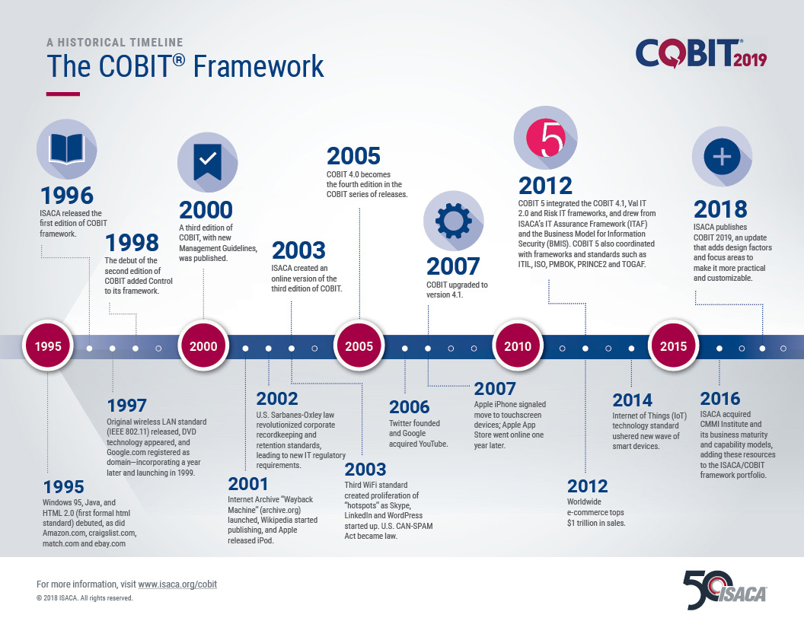

Slide 20
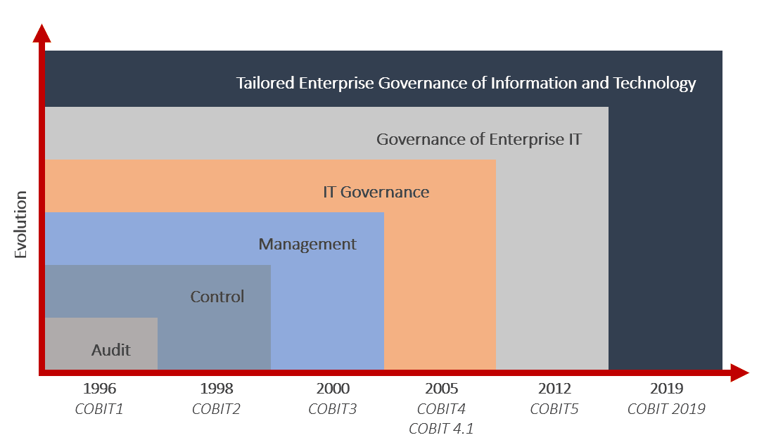

Slide 21
COBIT 2019 Core Focus: EGIT
COBIT 2019 focuses on Enterprise Governance of Information and Technology (EGIT).
It's not just about managing technology
It's about the governance system that ensures I&T aligns with business strategy.
Enterprise Governance of IT
Business/IT Alignment
Value Creation

Slide 22
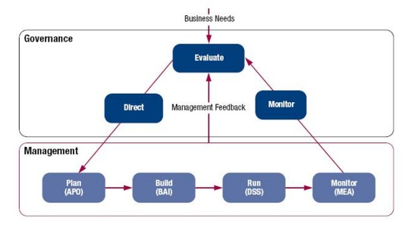
COBIT 2019 Domains

Slide 23
COBIT 2019 Domains
Governance Objectives
Management Objectives
EDM
Evaluate, Direct and Monitor
APO
Align, Plan and Organize
BAI
Build, Acquire and Implement
DSS
Deliver, Service and Support
MEA
Monitor, Evaluate and Assess
Evaluate strategic options, direct the chosen options and monitor strategy achievement.
Organize strategy and supporting activities for I&T.
Define, acquire and implement I&T solutions.
Operational delivery and support of I&T services.
Monitor performance and conformance of I&T.

Slide 24
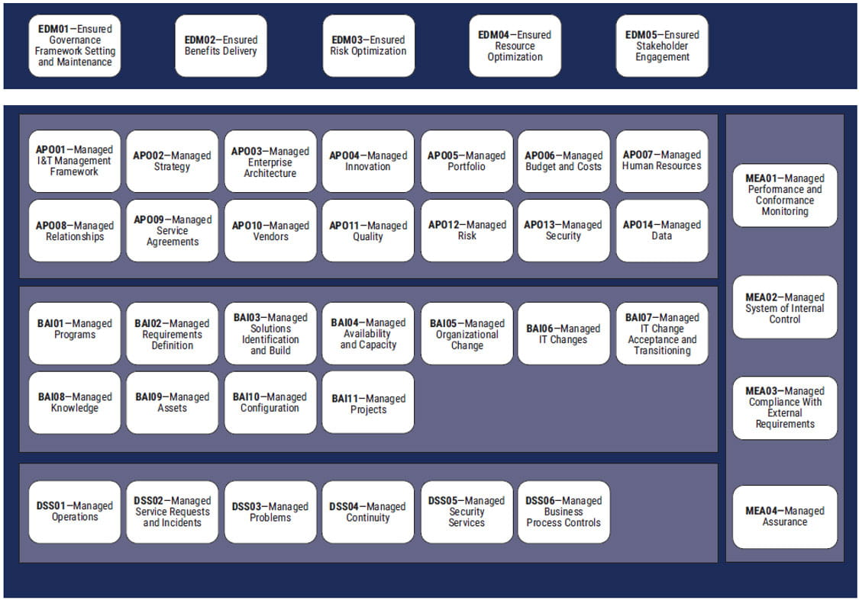
COBIT 2019 Core Model
The 40 objectives grouped in 5 domains

Slide 25
What is The Core Model for?
Represent everything an organization must govern and manage in relation to IT.
Act as a structured “to-do list” for effective IT governance.
Serve as a universal criteria for auditors.
Ensure consistency across organizations and industries.
Help organizations design or improve their IT governance system.

Slide 26
The 40 Objectives are “Catalog” not a “Mandatory”
Different organizations have different risks, strategies, and levels of IT dependency.
COBIT is a “design-your-own” governance framework.
Not all objectives are equally critical at all maturity levels.
Governance must be cost-effective.
The catalog ensures coverage, but not obligation.

Slide 27
An Illustration
A large retail company, MegaMart Indonesia, is evolving rapidly:
Moving from traditional stores → omnichannel (mobile app + e-commerce + physical stores)
Managing 20M customer accounts and loyalty points
Facing supply chain digitization and cybersecurity incidents
Needing better alignment between IT and business operations
The CEO says:
“We need IT to stop being just a support function. IT must help us innovate — safely, efficiently, and reliably.”
The CIO proposes using COBIT 2019 as the governance framework.

Slide 28
1. Understanding the Enterprise Needs
COBIT begins with goals, not with technology.
Enterprise goals for MegaMart:
Increase online revenue by 25%
Improve customer data protection
Reduce IT service outages
Optimize supply chain digitalization
Meet compliance requirements (PDPA-style regulations)
These goals become inputs into selecting relevant objectives.

Slide 29
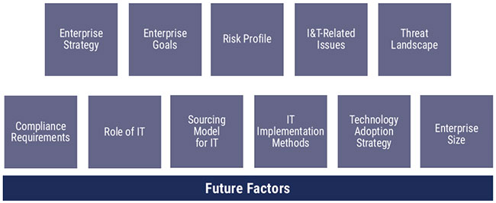
2. Using the Core Model as a Catalog
The CIO reviews the 40 COBIT objectives as a menu or catalog.
The point is not to implement all 40.
Instead, MegaMart identifies which objectives matter based on:
strategy
risk profile
scale
regulatory pressure
IT reliance
This is where COBIT's Design Factors come in.
COBIT 2019 Design Factors

Slide 30
3. Choosing the Relevant Objectives
EDM01 – Ensures Governance Framework Setting
APO02 – Managed Strategy
BAI03 – Managed Solutions Build
DSS01 – Managed Operations
MEA01 – Performance Monitoring
EDM02 – Ensures Benefits Delivery
APO12 – Managed Risk
BAI06 – Managed Change
DSS02 – Managed Incidents
MEA03 – Compliance Monitoring
EDM03 – Ensures Risk Optimization
APO13 – Managed Security
BAI08 – Managed Knowledge
DSS05 – Managed Security Services
EDM05 – Ensures Stakeholder Engagement
APO14 – Managed Data
BAI09 – Managed Assets
The Board wants structured oversight of IT investments and risks.
IT strategy, cybersecurity, and data governance are top priorities.
MegaMart is integrating ERP + e-commerce + loyalty systems.
Outages and cyber incidents directly impact sales and customer trust.
Executives want dashboards showing IT performance and compliance status.

Slide 31
4. Building IT Gov Structure
Example 1: EDM01 → Building the Governance Framework
Actions:
Form an IT Governance Committee
Define roles for CIO, CISO, Data Steward, Architecture Lead
Establish decision rights (who approves what)
Create policies (security, data, change, outsourcing)
COBIT provides the structure for each element.
Components of Gov System
Processes
Organizational structures
Information items
Skills and competencies
Culture and behavior
Policies and procedures
Services, infra, and app

Slide 32
4. Building IT Gov Structure
Example 2: APO02 → Align IT Strategy with Business Goals
Actions:
Create an IT Roadmap aligning with omnichannel expansion
Ensure each IT initiative links to specific enterprise goals
Define KPIs (e.g., app uptime, online conversion rate)
COBIT provides alignment principles and strategy practices.
Components of Gov System
Processes
Organizational structures
Information items
Skills and competencies
Culture and behavior
Policies and procedures
Services, infra, and app

Slide 33
4. Building IT Gov Structure
Example 3: APO14 → Implementing Data Governance
Actions:
Assign data owners for customer, product, and transaction data
Establish data lifecycle rules
Implement data quality monitoring
Define access criteria for personal information
COBIT provides guidance for ownership, quality, lifecycle, and security.
Components of Gov System
Processes
Organizational structures
Information items
Skills and competencies
Culture and behavior
Policies and procedures
Services, infra, and app

Slide 34
4. Building IT Gov Structure
Example 4: MEA01 → Monitoring and Dashboards
Actions:
Develop KPIs for service uptime, security, incidents, change success
Create monthly performance reports to governance committee
Benchmark performance against COBIT practices
COBIT provides recommended performance metrics.
Components of Gov System
Processes
Organizational structures
Information items
Skills and competencies
Culture and behavior
Policies and procedures
Services, infra, and app

Slide 35
5. Final Result: A Practical IT Governance
After 6 months, MegaMart achieves:
Clear IT decision-making structure
Improved alignment across business–IT initiatives
Reduced emergency changes by 40%
Faster incident response (improved by 30%)
Better data governance for customer protection
More reliable online services
Transparent reporting to leadership
Everything is built using selected COBIT 2019 Core Model objectives.

Slide 36
Exercise – COBIT 2019 Design Toolkit
Form a group of 2
Pick one out of two company profiles provided in the following slides
Open COBIT 2019 Design Toolkit
Fill out DF1 – DF10 that represents the company you picked
Check out the Step 3 Summary: Which objectives are important

Slide 37
1. PT Digital Nusantara Finansial (DNF)
PT Digital Nusantara Finansial adalah bank digital sekaligus penyedia layanan fintech yang sudah enam tahun beroperasi. Seluruh layanannya — pembukaan rekening, pinjaman mikro untuk UMKM, pembayaran, hingga investasi ritel — diberikan lewat aplikasi mobile, tanpa satu pun kantor cabang fisik. Saat ini perusahaan mempekerjakan sekitar 900 orang, dengan porsi terbesar berada di divisi teknologi dan produk.
Sejak awal, DNF memposisikan diri sebagai penantang bank konvensional. Yang mereka jual adalah pengalaman digital yang mulus dan fitur-fitur baru yang terus bermunculan lebih cepat daripada pesaing. Manajemen kerap menekankan bahwa "kalau berhenti berinovasi, kami mati", dan target pertumbuhan jumlah nasabah tiap kuartal selalu agresif. Efisiensi biaya bukannya diabaikan, tetapi jelas bukan yang utama; mereka lebih rela membakar anggaran demi akuisisi pengguna dan peluncuran produk baru.
Karena seluruh model bisnisnya berdiri di atas perangkat lunak, downtime aplikasi walau hanya beberapa menit langsung berdampak pada reputasi dan kepercayaan nasabah. Tim merilis pembaruan aplikasi nyaris setiap pekan menggunakan pendekatan pengembangan modern yang sangat mengandalkan rilis cepat dan otomatisasi. Sebagian besar sistem inti berjalan di layanan cloud publik, dengan sebagian kecil komponen sensitif masih dikelola sendiri, dan beberapa fungsi pendukung diserahkan ke vendor melalui integrasi API, termasuk skema open banking dengan mitra.
DNF beroperasi di industri yang sangat ketat pengawasannya. Otoritas jasa keuangan dan bank sentral menuntut kepatuhan yang tinggi, dan aturannya sering berubah mengikuti perkembangan teknologi finansial. Sebagai pemegang data keuangan jutaan nasabah, perusahaan ini juga menjadi sasaran empuk serangan siber; upaya peretasan, penipuan, dan phishing terhadap nasabah terjadi nyaris setiap hari, dan satu kebocoran data saja bisa berakibat fatal secara hukum maupun bisnis. Tantangan lain yang sering dikeluhkan internal adalah sulitnya merekrut dan mempertahankan talenta digital, serta ketegangan abadi antara keinginan merilis fitur secepat mungkin dengan kewajiban menjaga keamanan dan stabilitas.
Dalam hal teknologi, DNF dikenal sebagai perusahaan yang berani mencoba lebih dulu. Mereka termasuk yang paling awal mengadopsi teknologi baru di pasar, kadang sebelum teknologi itu benar-benar matang, karena percaya keunggulan kompetitif lahir dari sana.

Slide 38
2. PT Sentosa Manufaktur Indonesia (SMI)
PT Sentosa Manufaktur Indonesia adalah produsen komponen otomotif yang sudah berdiri 25 tahun. Pelanggan utamanya adalah perusahaan perakitan kendaraan (OEM) yang menuntut harga kompetitif, kualitas konsisten, dan pasokan yang tidak pernah telat. Perusahaan ini memiliki sekitar 700 karyawan, sebagian besar bekerja di pabrik, dengan tim teknologi informasi yang kecil dan ramping.
Daya saing SMI bertumpu pada efisiensi biaya dan keandalan. Margin di industri komponen tipis, sehingga manajemen sangat fokus menekan biaya produksi, merapikan proses, dan menjaga agar lini produksi terus berjalan tanpa gangguan. Pertumbuhan tetap diinginkan, tetapi dengan cara yang hati-hati dan bertahap; inovasi produk bukanlah hal yang mereka kejar, sebab spesifikasi komponen umumnya sudah ditentukan oleh pelanggan OEM.
Teknologi informasi di SMI berperan sebagai penopang operasional, bukan sumber keunggulan kompetitif. Mereka mengandalkan sistem ERP untuk keuangan dan logistik, serta sistem di lantai pabrik untuk mengatur produksi. Sistem-sistem ini sebagian besar sudah berjalan bertahun-tahun, stabil, dan jarang diubah. Bila sistem produksi terganggu, jalur perakitan bisa berhenti dan pengiriman ke pelanggan terlambat — inilah risiko operasional yang paling mereka takuti. Pengembangan dan perubahan sistem dilakukan secara perlahan dan terencana, biasanya lewat proyek besar yang jarang frekuensinya, dengan banyak pekerjaan implementasi diserahkan kepada vendor penyedia ERP dan mitra integrator. Infrastruktur masih banyak dikelola di pusat data sendiri.
SMI tidak berada di industri yang superketat regulasi keuangan, tetapi tetap harus mematuhi standar mutu otomotif, aturan ketenagakerjaan, serta ketentuan keselamatan dan lingkungan. Ancaman siber memang ada, tetapi profilnya relatif normal dibanding sektor keuangan; perhatian mereka lebih besar pada keandalan pemasok dan kontinuitas rantai pasok, karena keterlambatan satu pemasok bahan baku bisa mengganggu seluruh jadwal produksi.
Soal teknologi, SMI cenderung menunggu. Mereka baru mengadopsi teknologi baru setelah terbukti matang, andal, dan jelas memberi penghematan biaya. Filosofi mereka: lebih baik telat tetapi aman, daripada menjadi kelinci percobaan teknologi yang belum teruji.

Slide 39
Auditing IT Governance

Slide 40
The Urgency of Auditing IT Governance
IT Governance failures cause:
misalignment
project failure
data breaches
operational losses
compliance issues
Key idea: We audit IT Governance to ensure direction, oversight, and accountability are working as intended.

Slide 41
Using COBIT 2019 as Audit Criteria
Why COBIT is suitable for governance auditing:
internationally recognized
covers all governance & management components
provides criteria, activities, and practices
COBIT gives auditors a structured, neutral, complete criteria set.

Slide 42
Selecting Relevant COBIT Objectives for Audit
Auditors don’t audit all 40 objectives
Selection depends on:
organization’s strategy
risk profile
regulatory requirements
current maturity
known pain points
Link back to the MegaMart case
Understand enterprise goals
Understand IT environment
Identify high-risk COBIT domains
Select relevant objectives

Slide 43
Understanding COBIT Components
Each COBIT objective contains:
Objective statement → what it must achieve
Purpose → why it exists
Gov/Management practices → the “audit criteria”
Inputs / Outputs → audit evidence
RACI → roles to interview
Metrics → performance & conformance indicators
Key idea: This structure tells auditors what to test, who to ask, and what evidence to collect.

Slide 44
How to Perform an Audit of IT Governance Using COBIT
Plan the Audit
Understand the Governance Structure
Evaluate Design of Controls / Governance Practices
Test Control and Activities
Assess Capability or Maturity (Optional)
Form Conclusions and Recommendations

Slide 45
1. Plan the Audit
Example
A retail company, “ShopNow”, is rolling out a new customer-facing mobile app. Audit scope is focused on IT governance over digital services, specifically the COBIT objectives:
EDM02 (Ensure Benefits Delivery)
APO01 (Manage the IT Management Framework)
APO12 (Manage Risk)
You define what you are auditing, why, and against which criteria (COBIT objectives).
You must identify:
Objective (e.g., “Is IT Governance effective?”)
Scope (which COBIT objectives? EDM01? APO01? etc.)
Risks
Resources and schedule

Slide 46
2. Understand the Governance System
Example
During interviews, the auditor learns:
There is an IT Steering Committee but it has not met for 4 months.
The CIO reports directly to the COO, but the digital product team bypasses IT governance in urgent releases.
The risk function is not involved in sprint planning.
This helps the auditor understand where governance may be weak.
Here you learn how IT decisions are actually made inside the organization.
You examine:
Governance bodies (board, IT steering committee)
Decision rights (who approves what)
Policies & charters
Enterprise goals & IT alignment
Reporting lines
COBIT Governance System Components
This forms the baseline of what “exists” before testing anything.

Slide 47
3. Evaluate Design of Controls / Governance Practices
Example
For EDM02, COBIT expects benefit delivery mechanisms. The auditor reviews ShopNow’s governance practices and finds:
Business case exists, but no benefit tracking after app release.
No governance trigger when expected customer adoption falls below target.
No clear owner assigned to track KPIs.
This shows gaps in governance design and operation.
Now you compare the organization’s governance design to COBIT’s recommended practices.
You check:
Are the right policies defined?
Are governance committees structured appropriately?
Are roles aligned with COBIT’s RACI?
Do the expected practices exist in the design?

Slide 48
4. Test Control and Activities
Example
The auditor tests if risk assessments (APO12) are happening before major releases:
Reviews three release cycles → only one has a documented risk assessment.
Risk mitigation decisions are not approved by any governance body.
Evidence shows developers pushed a hotfix directly to production without oversight.
Testing confirms that governance controls exist on paper but do not operate consistently.
Now you check whether the governance practices actually work in real life.
Methods include: Interviews, Document review, Observation, Evidence sampling, Decision trail examination, Meeting minutes analysis
You test whether:
Meetings happen as chartered
Risks are being escalated
Projects are prioritized correctly
IT investments are monitored
Policies are followed

Slide 49
5. Assess Capability or Maturity (Optional)
Example
Based on evidence:
EDM02: Level 1 (Performed) – benefits are identified but not systematically monitored.
APO12: Level 0–1 – risk management is inconsistent and mostly reactive.
APO01: Level 2 – there is an IT management framework but not fully embedded.
Simple, consistent scoring supports improvement planning.
Using COBIT’s Performance Management Model, auditors can score how mature or capable each objective is (0–5). This is optional but often requested by management.
The rating helps communicate:
How strong the governance process is
Where improvements are needed
Progress over time

Slide 50
6. Form Conclusions and Recommendations
Example
Conclusion for ShopNow:
Governance bodies are not functioning effectively.
Benefits and risks of the mobile app are not governed systematically.
Governance roles are blurred between IT, digital product, and risk teams.
Recommendations:
Reactivate IT Steering Committee with monthly meetings.
Assign an owner responsible for benefit tracking and KPI reviews.
Require risk assessment for every major release before approval.
Integrate product teams into the formal governance framework (APO01).
Finally, auditors:
Summarize gaps
Explain risks
Conclude on governance effectiveness
Provide prioritized recommendations
Align findings with enterprise goals
Recommendations must be:
Practical
Risk-based
Aligned with COBIT Design Factors

Slide 51
Cheatsheet of Auditing
#ToD #ToE #ST

Slide 52
Audit Step Simplification
In most cases, audit is about evaluating whether certain risks are threatening the achievement of objectives or not.
The most practical way of doing it is through testing the existing controls
Test of Control
Substantive Test

Slide 53
Audit Step Simplification
Test of Design
Test of Effectiveness
Substantive Test
Evaluate whether the control is designed properly to prevent, detect, or correct errors.
You check policies, procedures, responsibilities, workflows, and whether the design makes sense.
Check whether the control actually works in practice, not just on paper.
You verify evidence, logs, samples of activities, or observe how the process runs daily.
Directly test the transactions, records, or results to detect misstatements or irregularities.
This step checks the actual outcome, especially when controls are weak.

Slide 54
Audit Step Simplification
Test of Design
Test of Effectiveness
Substantive Test
Desain Pengendalian Memadai?
Pengendalian Berfungsi?
Ya
Ya
Pengujian Terbatas / Uji Petik
Tidak
Tidak
Uji Substantif Mendalam

Slide 55
Assignment I – Design Audit Scope
This assignment trains you to:
Read and understand a practical organizational context.
Identify relevant COBIT 2019 governance and management objectives that should be included in an audit scope.
Explain why those objectives matter based on risks or conditions in the case.
Extract governance/management practices and activities directly from the COBIT 2019 Governance & Management Objectives book.
Connect the COBIT model to real auditing decisions.
You will need to use COBIT 2019 Framework Governance & Management Objectives publication as attached in class logistic.

Slide 56
CASE: PT Sinar Jaya Digital (SJD)
SJD is a mid-sized e-commerce company facing rapid growth. The company relies heavily on IT to process transactions, handle customer data, and manage its logistics partners. Several issues have emerged:
The board receives limited reporting on IT risks and performance.
IT decisions are made by the IT Manager without clear alignment to business priorities.
There is no formal risk management, although the company has experienced 2 outages in the past 6 months.
Change requests (new features, bug fixes) are handled informally through WhatsApp.
Customer complaints spike whenever the website suffers slowdowns.
No one is clearly accountable for cybersecurity measures; employees mix personal and corporate credentials.
The company plans major expansion next year, but IT planning is mostly reactive.
SJD’s Internal Audit is asked to perform a limited-scope IT Governance review to determine whether IT is being managed properly to support business objectives.

Slide 57
Task Instructions
Use COBIT 2019 Design Toolkit (optional)
Select COBIT Objectives (1 Governance + 3 Management) based on the importance
Extract the Practices and Activities
Submit a Structured Document (PDF)

Slide 58
1. Select COBIT Objectives
Choose at least 1 Governance Objective (EDM domain) relevant to SJD’s situation.
Choose at least 3 Management Objectives (APO, BAI, DSS, MEA domains) that should be included in the audit scope.
Your output must include:
The selected objectives (e.g., EDM02, APO12, BAI06…)
A brief explanation (5–7 sentences total) answering:
Why is this objective relevant to the case?
What risk or problem does it address?
Why should Internal Audit review it now?

Slide 59
2. Extract the Practices and Activities
For each selected objective:
List all Governance or Management Practices
Under each practice, list the activities related to it
Attach screenshots from the COBIT 2019 Governance & Management Objectives book showing the practices and activities.
Instructions for evidence:
Screenshot must clearly show the objective title, each practice and its activities
You must not share PDFs; only screenshots of the parts used

Slide 60
Example
Objective: APO12 Managed Risk
Practice: APO12.01 – Collect and Maintain Risk Information
Activities (from book)
Screenshot provided
Bullet summary of each activity copied from the book
Practice: APO12.02 – Analyze Risk
Activities (from book)
Screenshot provided
Bullet summary copied
(Repeat for all practices)

Slide 61
3. Submit a Structured Document (PDF)
Your submission must include:
Selected Objectives + Rationale
Practices & activities (with screenshot evidence)
Short conclusion: “What would be the main audit focus if these objectives are selected?”
Submit your report here:
https://forms.gle/ewcaJ5Tv7xs1rrHM6

